Slide 1

Unlocking Emotions: An Introduction to Multimodal Sentiment Analysis
Text-only sentiment analysis misses emotional nuance. Multimodal sentiment combines text, visuals, and audio for richer insights. This approach enhances customer understanding and supports mental health monitoring.

Slide 2

What is Multimodal Sentiment Analysis?
Combines textual, visual, and auditory data.
Example: Video reviews include transcript, facial cues, and tone.
Analyzes sentiment more like humans do.
Captures complex emotional states holistically.

Slide 3

The Modalities: Seeing, Hearing, and Reading Emotions
Textual
Visual
NLP extracts emotion from words and phrases.
Facial expressions and body language recognized via computer vision.
OpenFace achieves >90% accuracy on landmarks.
Auditory
Speech Emotion Recognition analyzes tone, pitch, cadence.
IEMOCAP dataset trains models with 75%+ accuracy.

Slide 4
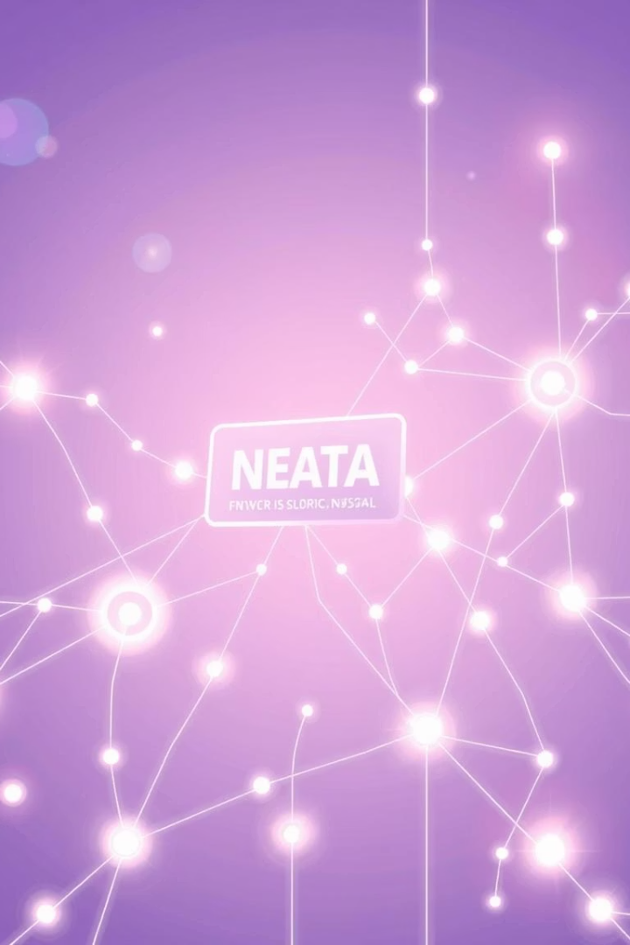
Model Architecture: Fusing the Senses
Feature extraction
Fusion methods
Pre-trained models like BERT and ResNet extract key features.
Early fusion concatenates features; late fusion merges predictions.
Classification
Algorithms predict sentiment polarity (e.g., SVM, neural nets).

Slide 5




Deep Dive: Attention Mechanisms
Focus on relevance
Model attends to key modalities dynamically.
Example
More focus on facial expressions during emotional moments.
Transformers
“Attention is all you need” enables effective fusion and context modeling.

Slide 6
Real-World Applications: Customer Insights
Social Media Monitoring
Customer Service
Market Research
Gain brand perception insights from multimodal data. +20% customer satisfaction.
Auto-analyze chats and calls to prioritize issues. Cuts resolution time by 15%.
Track sentiment on products via multimodal feedback. Boosts adoption by 10%.

Slide 7
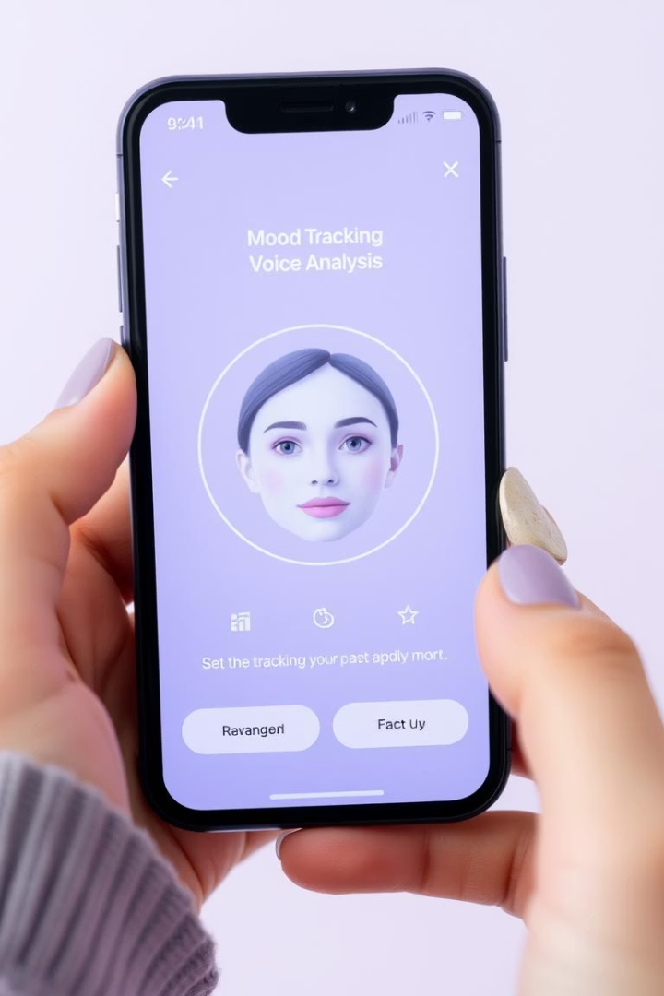
Applications: Mental Health and Beyond
Mental Health Monitoring
Human-Robot Interaction
Speech and facial cues detect depression with 80% accuracy.
Emotionally aware robots improve engagement by 25%.
Education
Analyze student emotions to improve online learning outcomes by 15%.

Slide 8
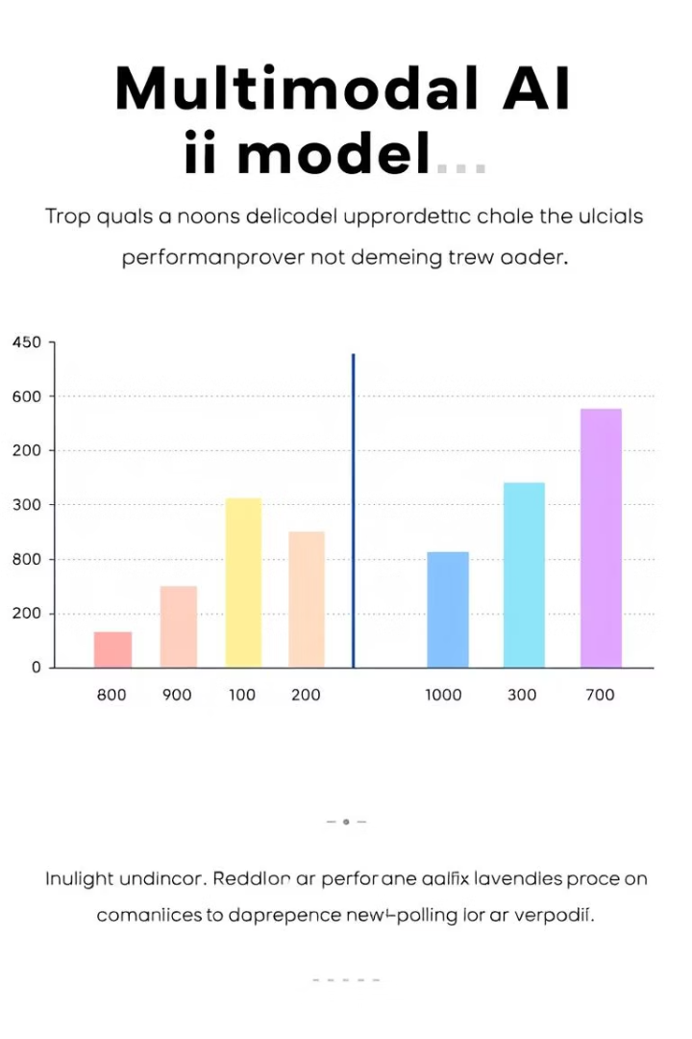
Benefits: Accuracy, Nuance, and Actionable Insights
Increased accuracy
Deeper understanding
Outperforms unimodal models by 15-20% in detection.
Captures subtle context missed by text-only analysis.
Actionable insights
Delivers richer, data-driven decision-making support.

Slide 9




Future Trends: Advancements on the Horizon
More modalities
Incorporating physiological data for deeper emotional insight.
Self-supervised learning
Reducing dependency on labeled data with new training methods.
Explainable AI
Methods to understand and trust predictions will improve transparency.

Slide 10

Ethical Considerations: Bias and Privacy
Bias in data
Privacy concerns
Diverse datasets needed to reduce bias affecting 30% of AI apps.
Safeguard sensitive info, especially in mental health. Anonymization cuts risk by 50%.
Responsible AI
Emphasize fairness, transparency, and accountability in design and use.

